Slide 1

XPS Analyzer
04/25 Lab Meeting
04/25 Lab Meeting
KHU SpondLab
최 정 훈

Slide 2
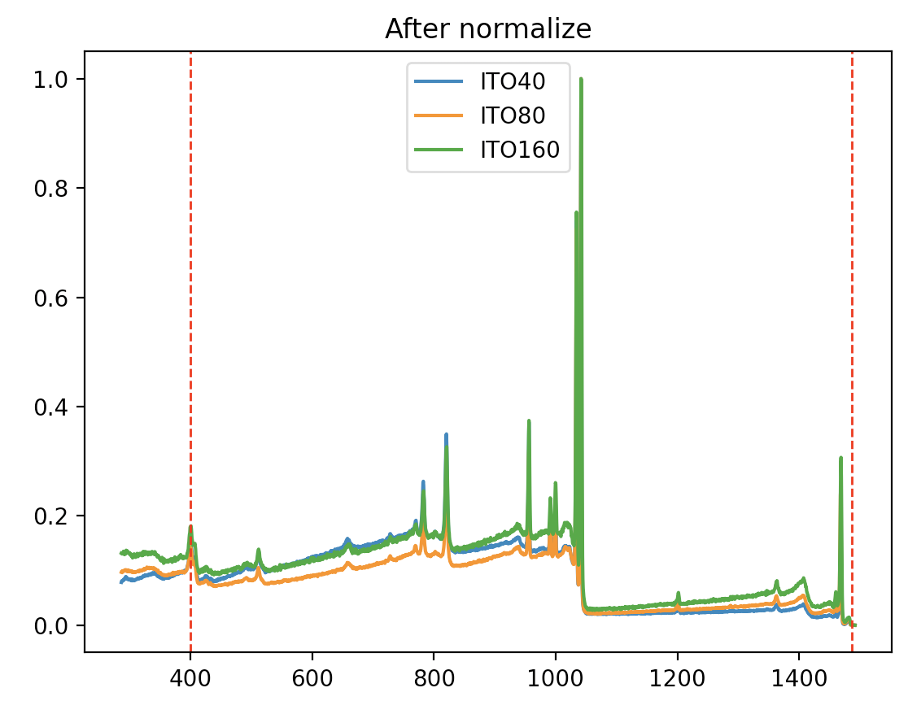
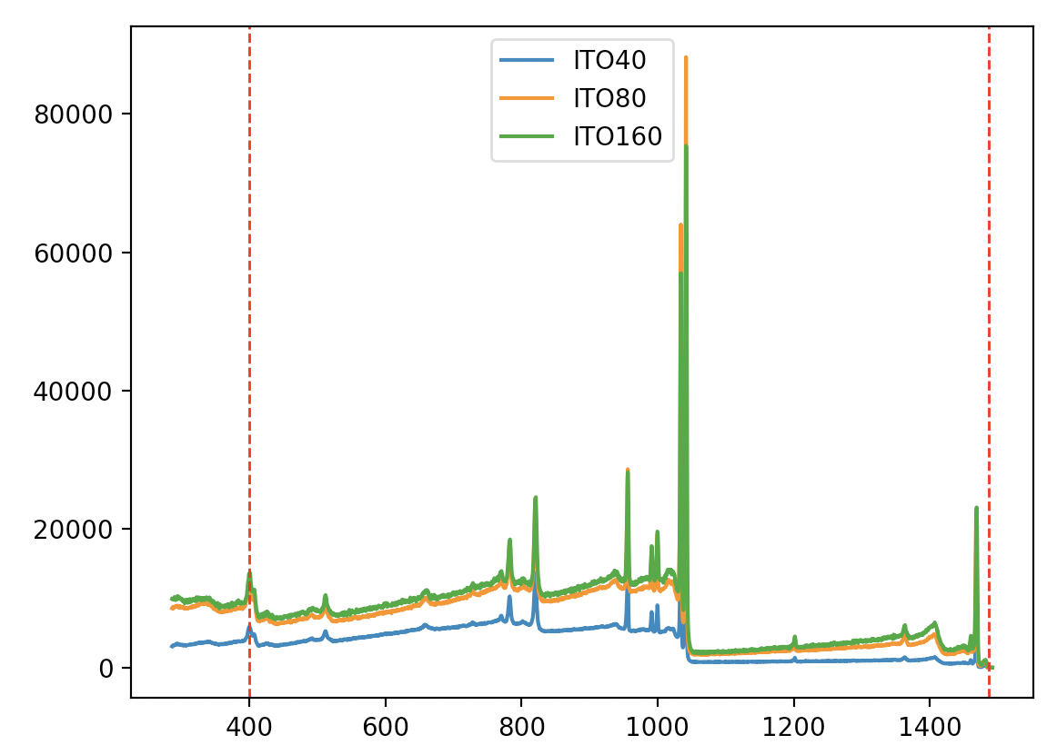
04/25 Lab Meeting
SPOND
Notes:
https://iopscience.iop.org/article/10.1088/2632-2153/ab5da6

Slide 3
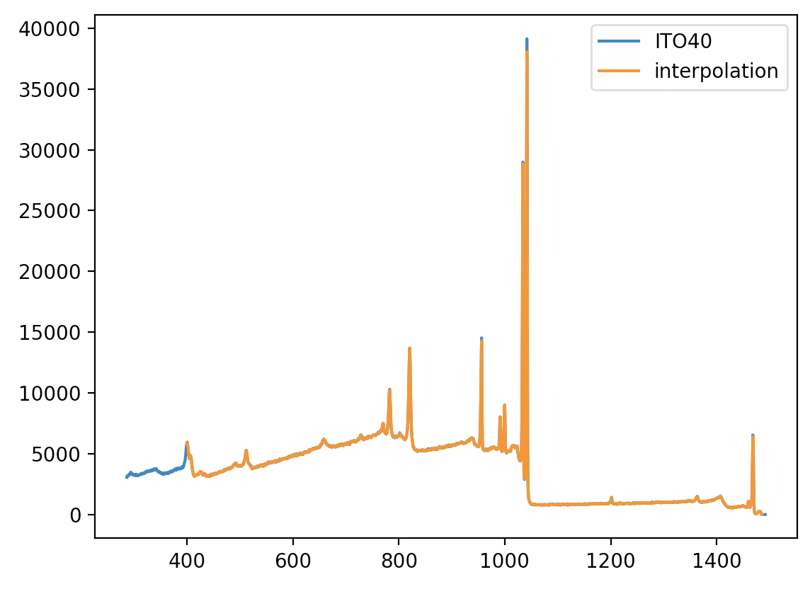
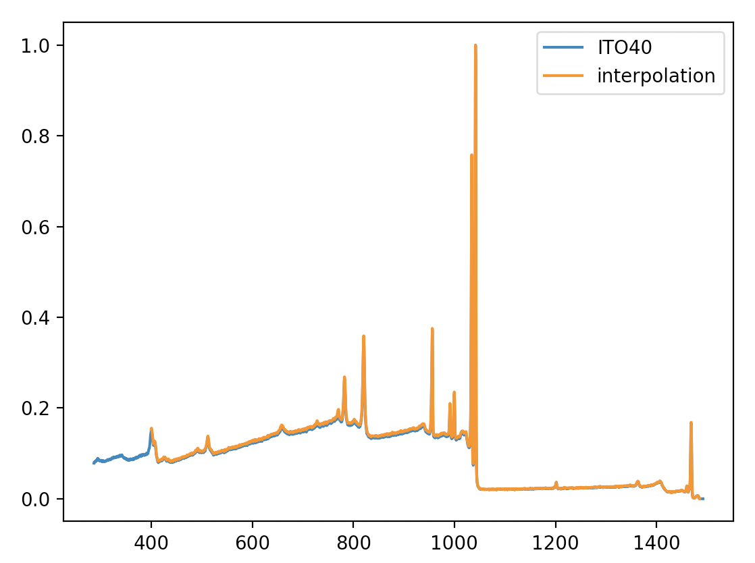
04/25 Lab Meeting
SPOND
선형 interpolation
Train data
400.000 ~ 1485.470 [2048 rows]
Interval: 0.53
ITO40
286.69 ~ 1491.69 [2411]
Interval: 0.5
>>> np.diff(ITOsessa.index)
array([0.53 , 0.531, 0.53 , ..., 0.53 , 0.53 , 0.53 ])
Notes:
https://iopscience.iop.org/article/10.1088/2632-2153/ab5da6

Slide 4
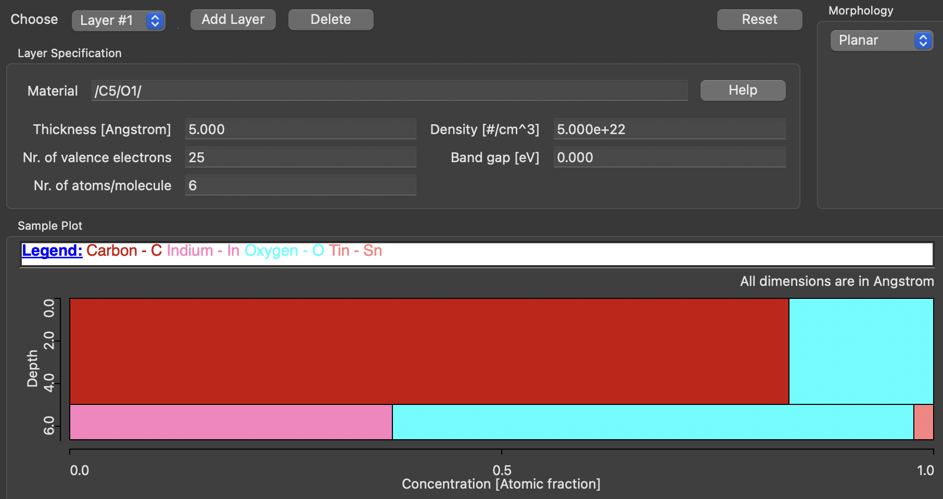
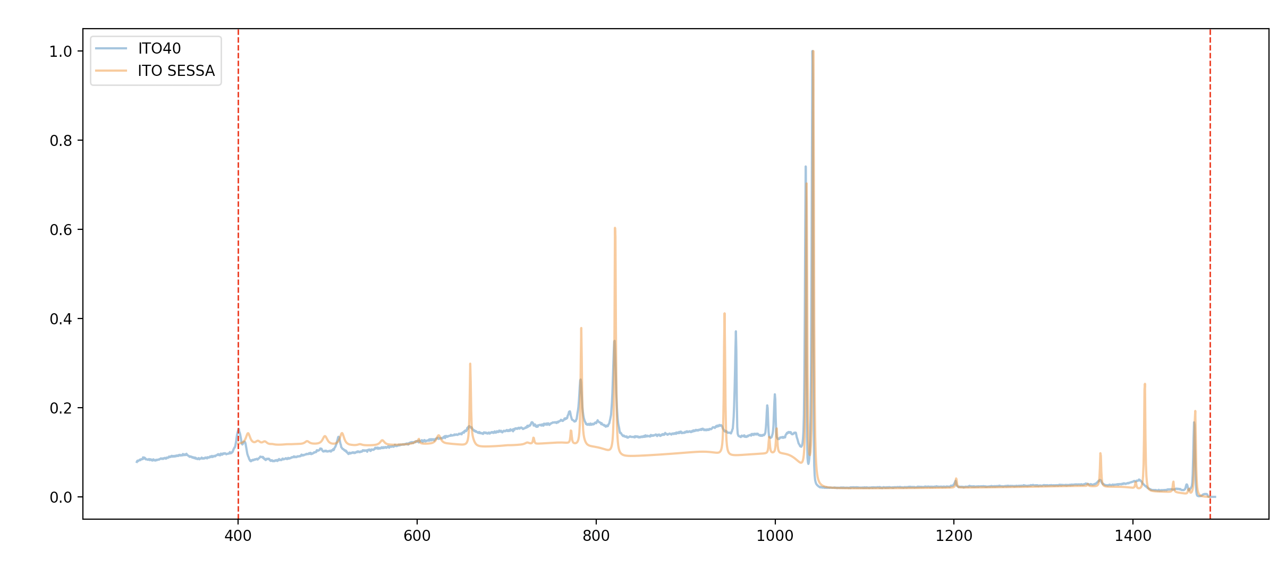
04/25 Lab Meeting
SPOND
ITO XPS SESSA built
/In2/O3/ (90%) + /Sn/O2/ (10%) + /C5/O1/ (1Å)
Notes:
https://iopscience.iop.org/article/10.1088/2632-2153/ab5da6

Slide 5
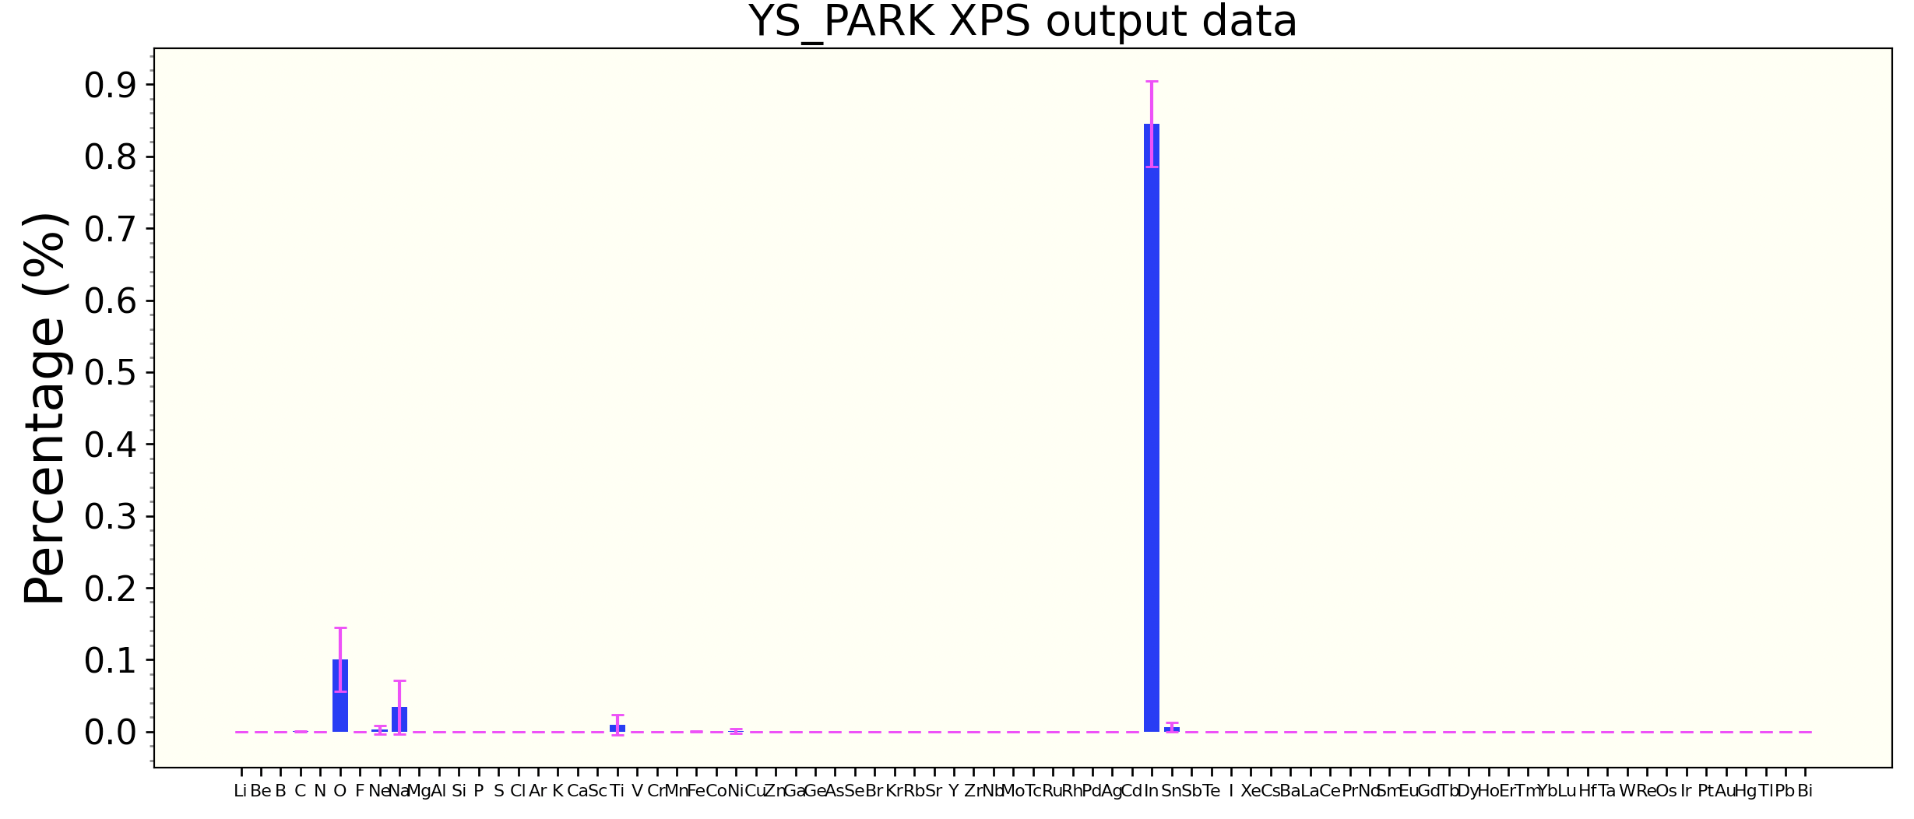
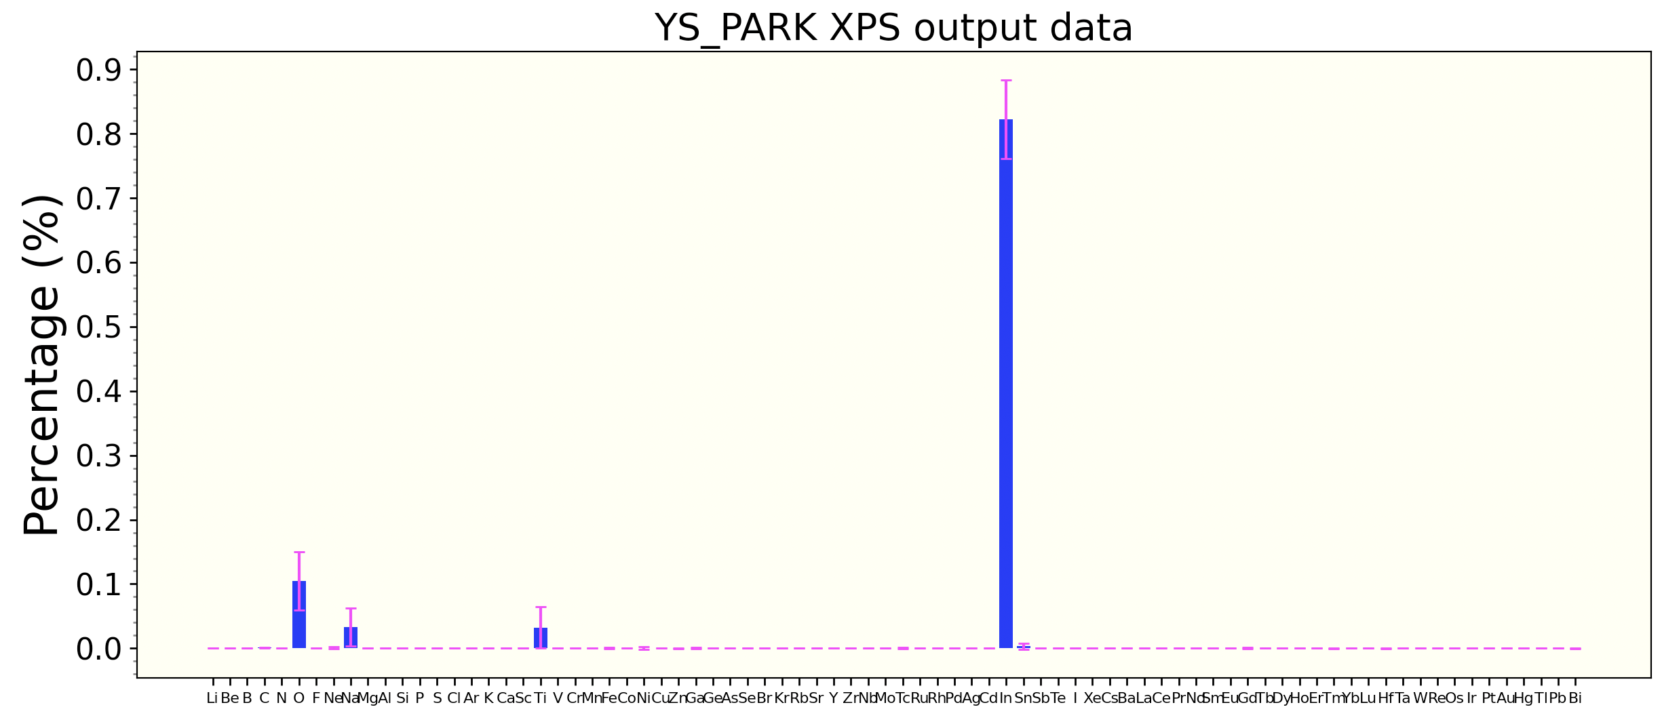
04/25 Lab Meeting
SPOND
ITO40
ITO80
Notes:
https://iopscience.iop.org/article/10.1088/2632-2153/ab5da6

Slide 6
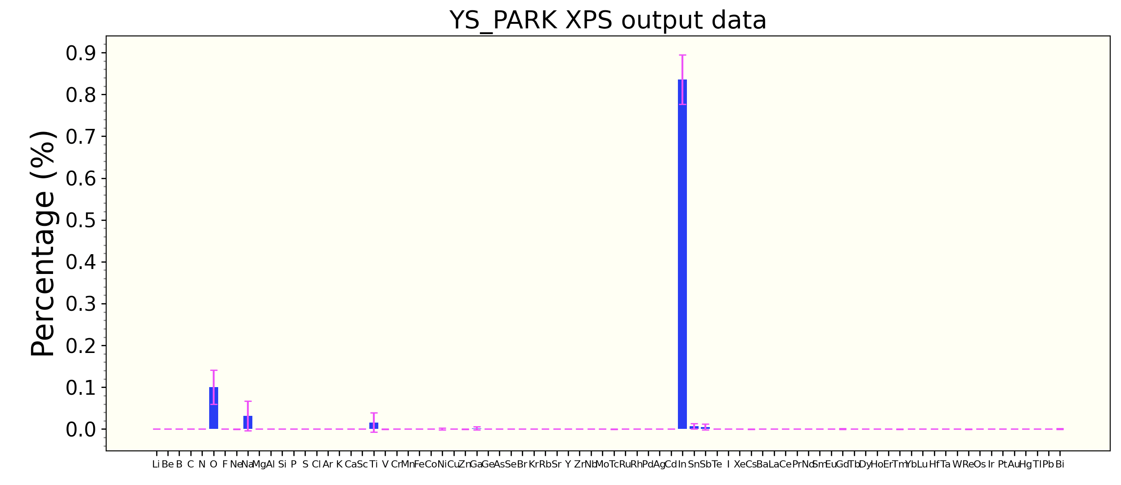
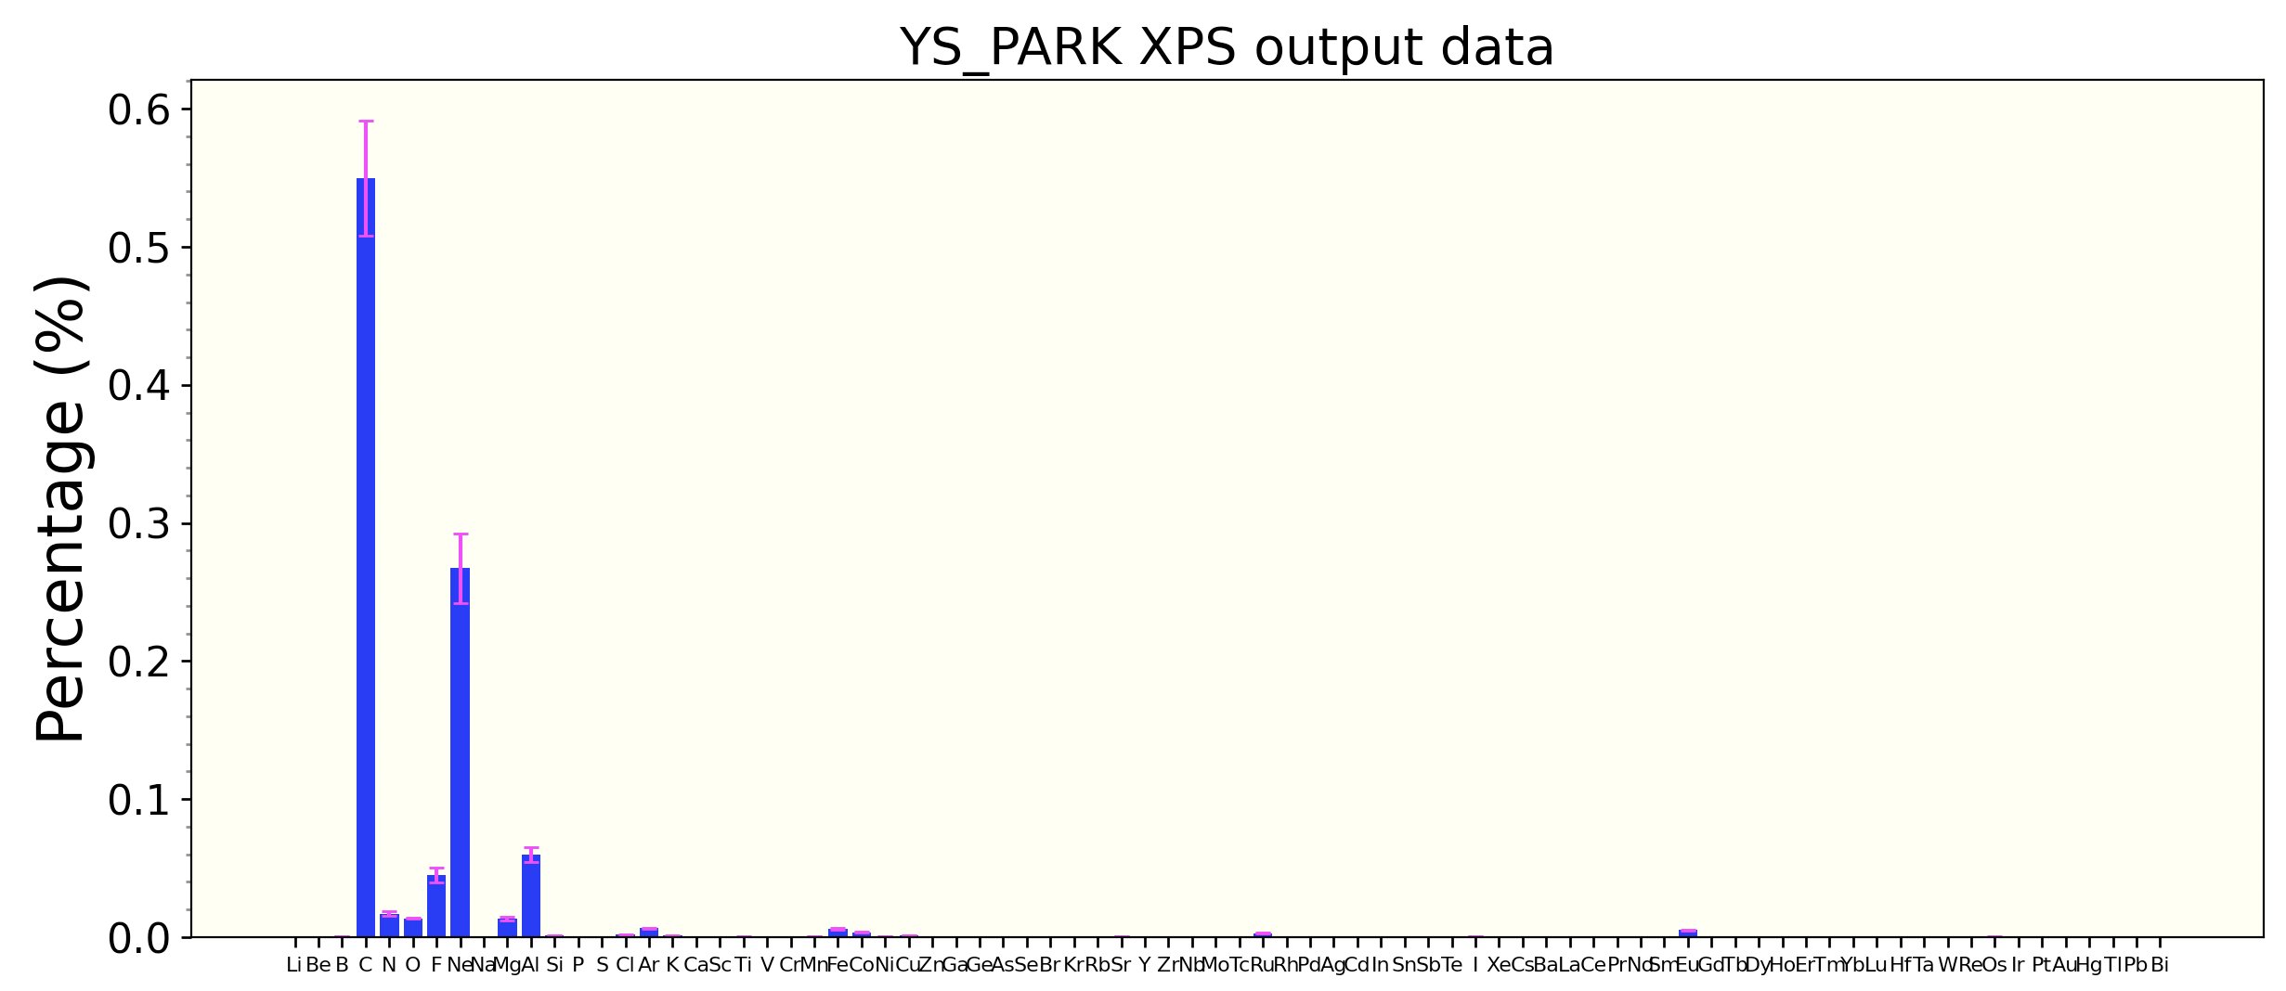
04/25 Lab Meeting
SPOND
ITO160
ITO sessa
??...
Random shift를 하지 않아서 그런건가…?
Notes:
https://iopscience.iop.org/article/10.1088/2632-2153/ab5da6

Slide 7
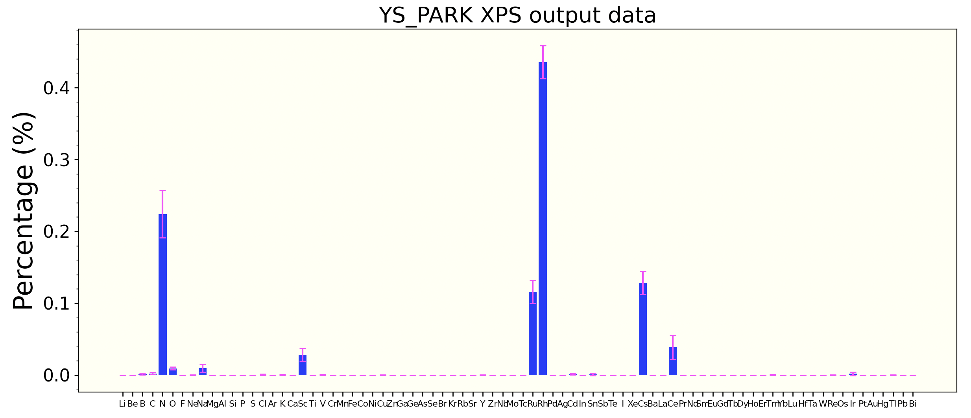
04/25 Lab Meeting
SPOND
# /N50/Rh30/Ru11/Cs8/Ce1/ [3.01]
>>> 40*pred
array([[4.5448422]], dtype=float32)
Notes:
https://iopscience.iop.org/article/10.1088/2632-2153/ab5da6

Slide 8
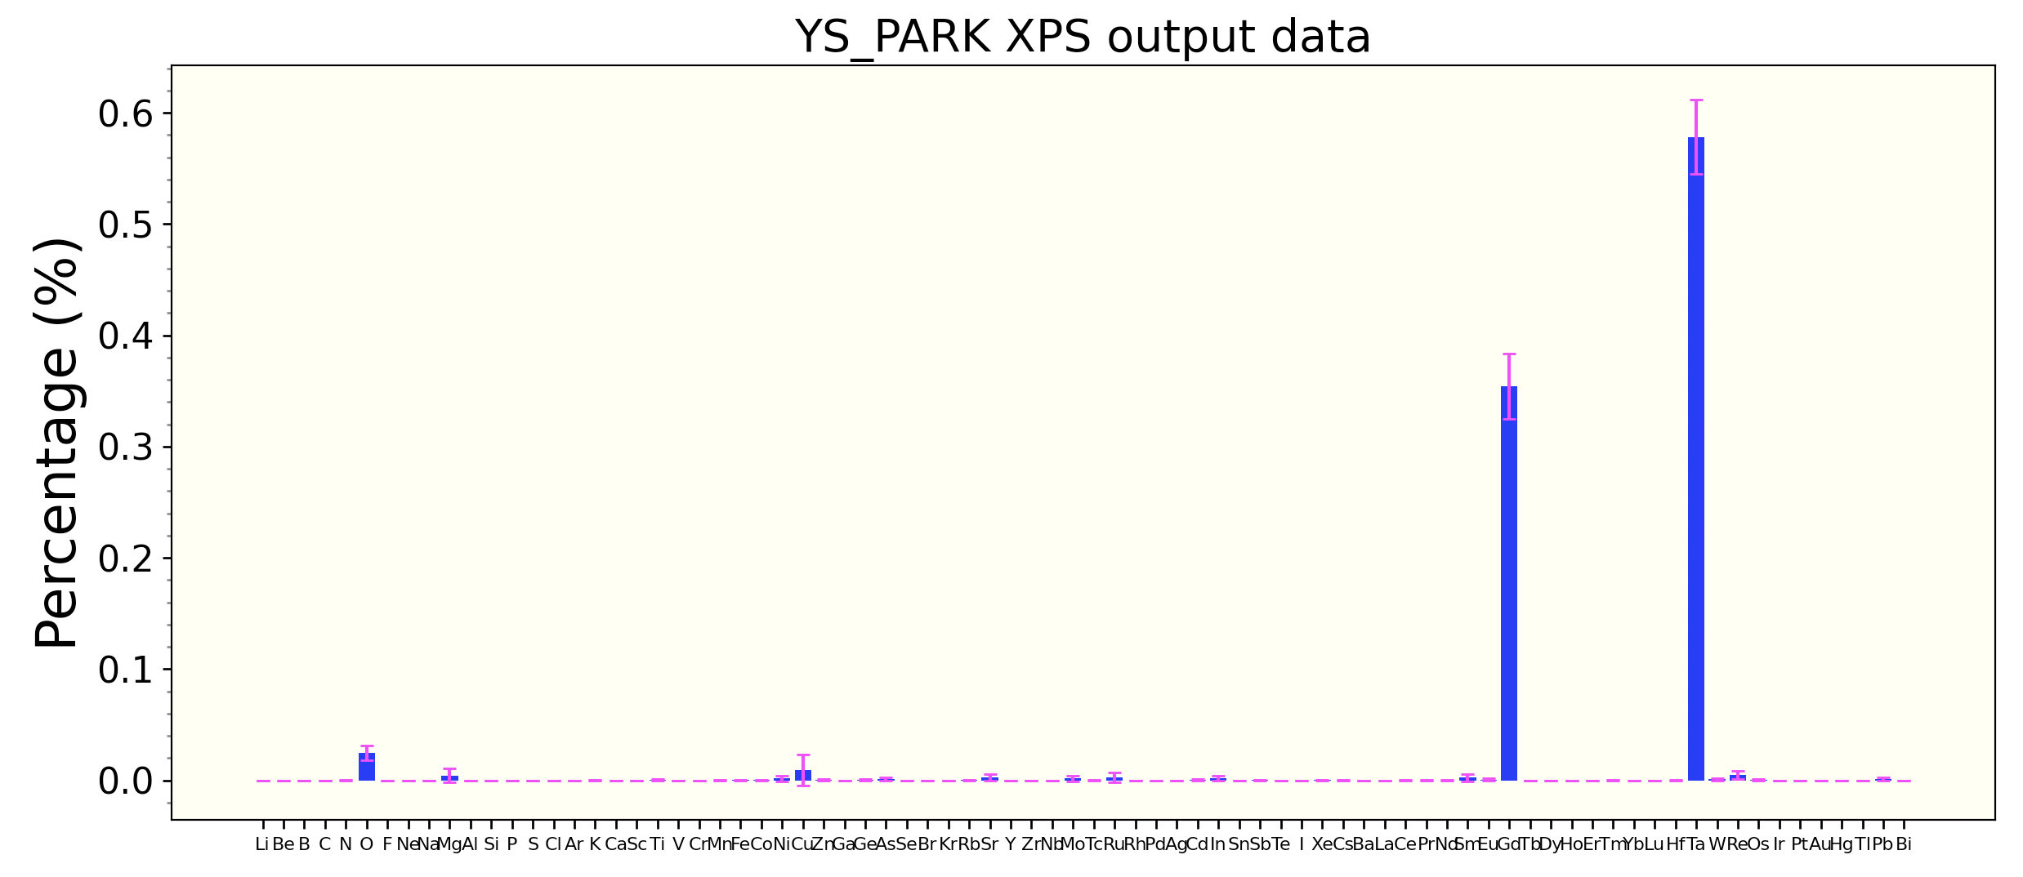
04/25 Lab Meeting
SPOND
# /Gd54/Ta46/ [38.51]
>>> pred*40
array([[37.138092]], dtype=float32)
Notes:
https://iopscience.iop.org/article/10.1088/2632-2153/ab5da6

Slide 9
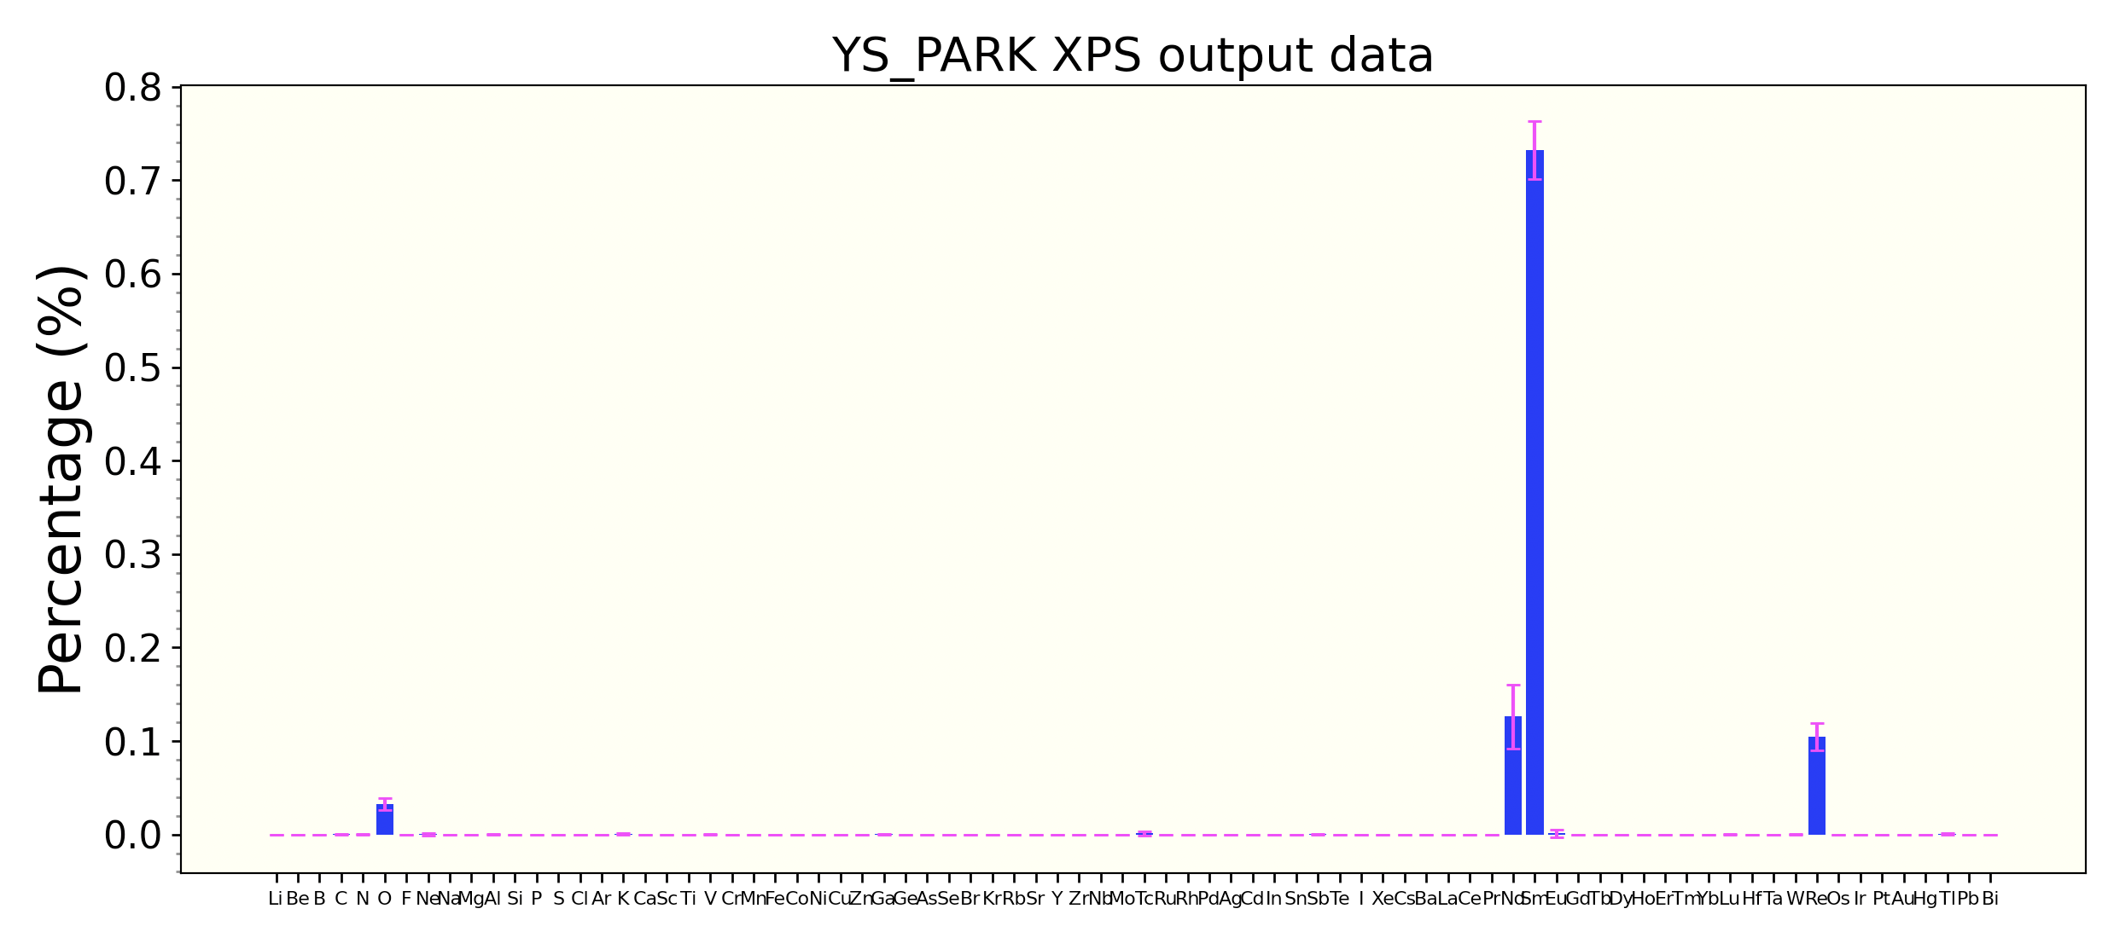
04/25 Lab Meeting
SPOND
# /Sm71/Re14/Nd12/Co3/ [20.38]
>>> pred*40
array([[20.881931]], dtype=float32)
Notes:
https://iopscience.iop.org/article/10.1088/2632-2153/ab5da6

Slide 10
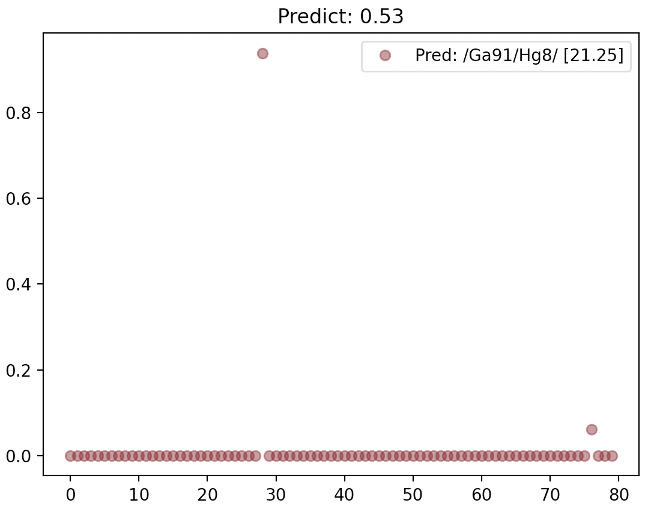
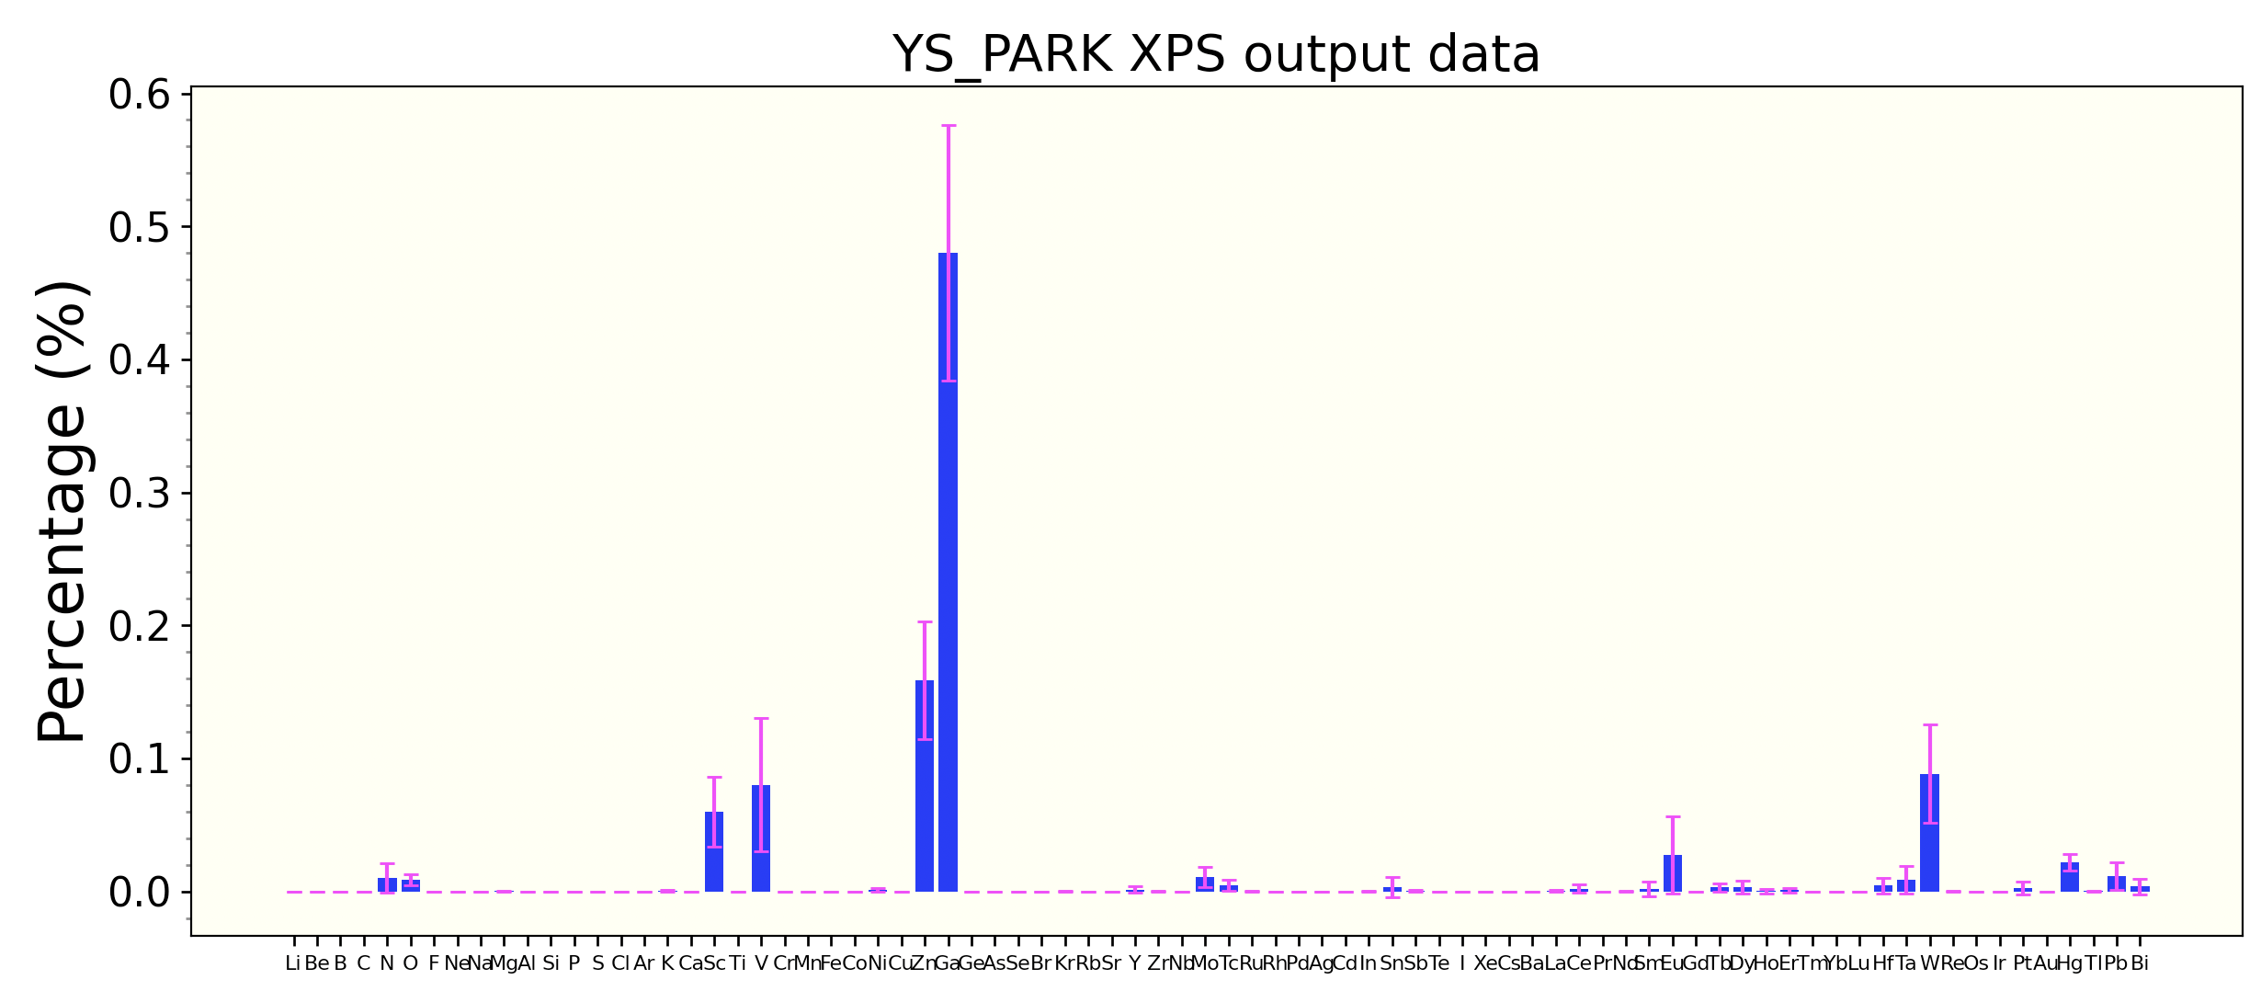
04/25 Lab Meeting
SPOND
# /Sm71/Re14/Nd12/Co3/ [20.38]
Notes:
https://iopscience.iop.org/article/10.1088/2632-2153/ab5da6

Slide 11
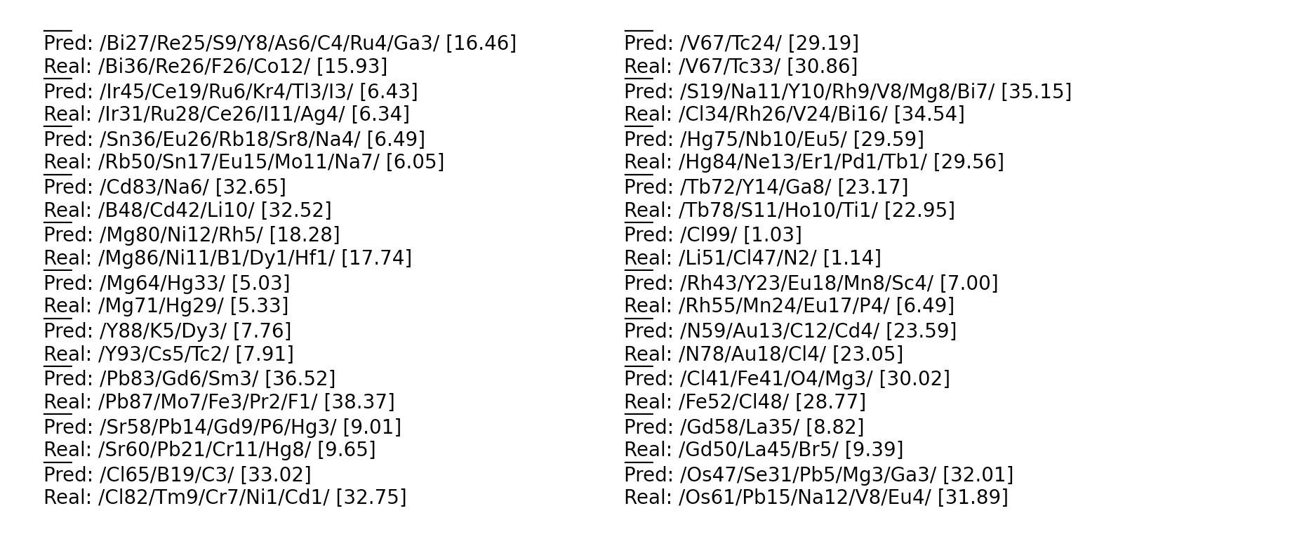
04/25 Lab Meeting
SPOND
이전에 batch size ==1 로 학습했던 모델 (XPS_weights_11.h5)
Notes:
https://iopscience.iop.org/article/10.1088/2632-2153/ab5da6

Slide 12
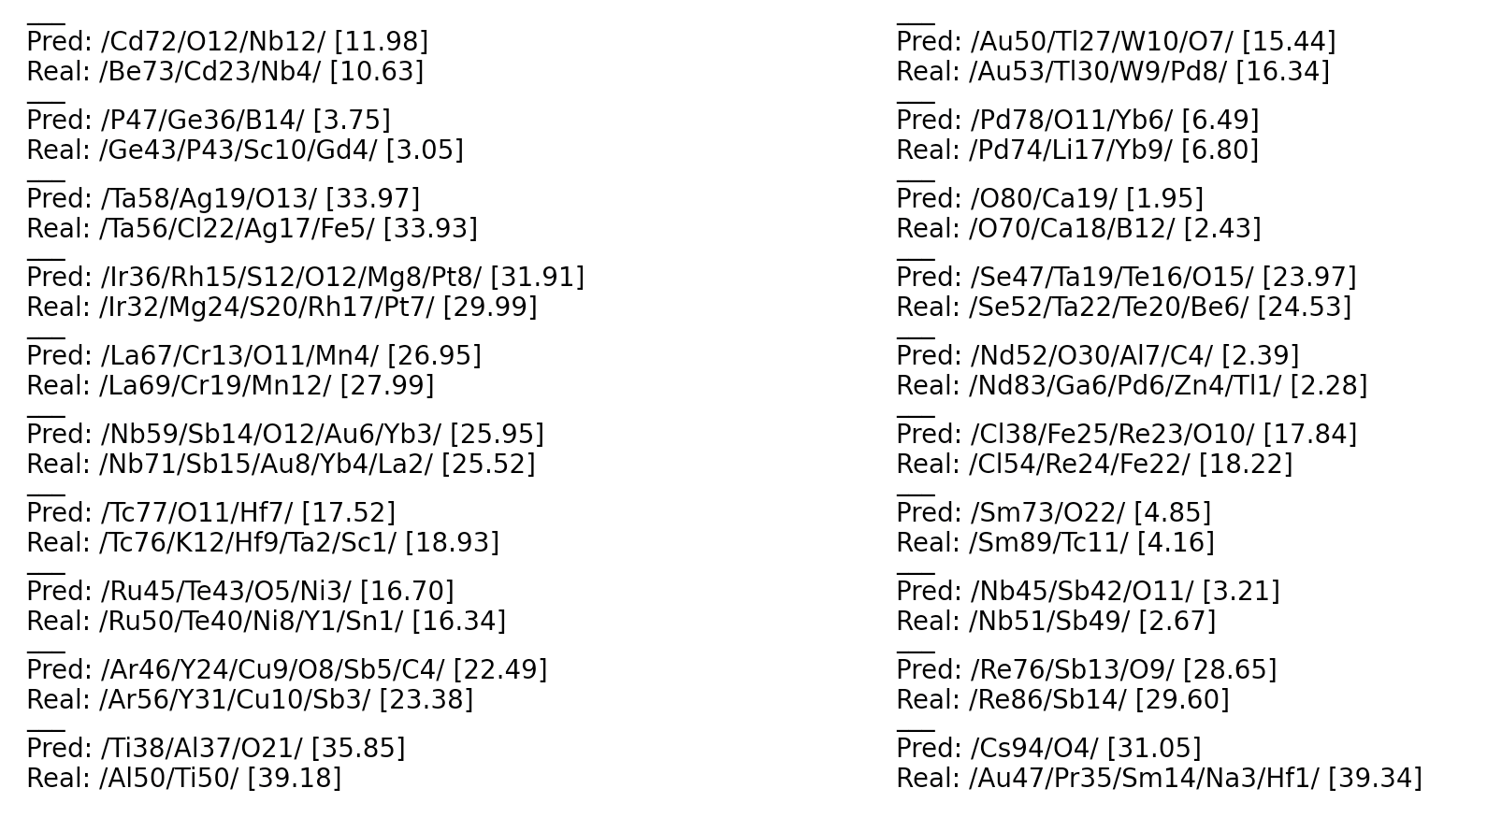
04/25 Lab Meeting
SPOND
이인호 박사님의 변형 모델
Notes:
https://iopscience.iop.org/article/10.1088/2632-2153/ab5da6

Slide 13
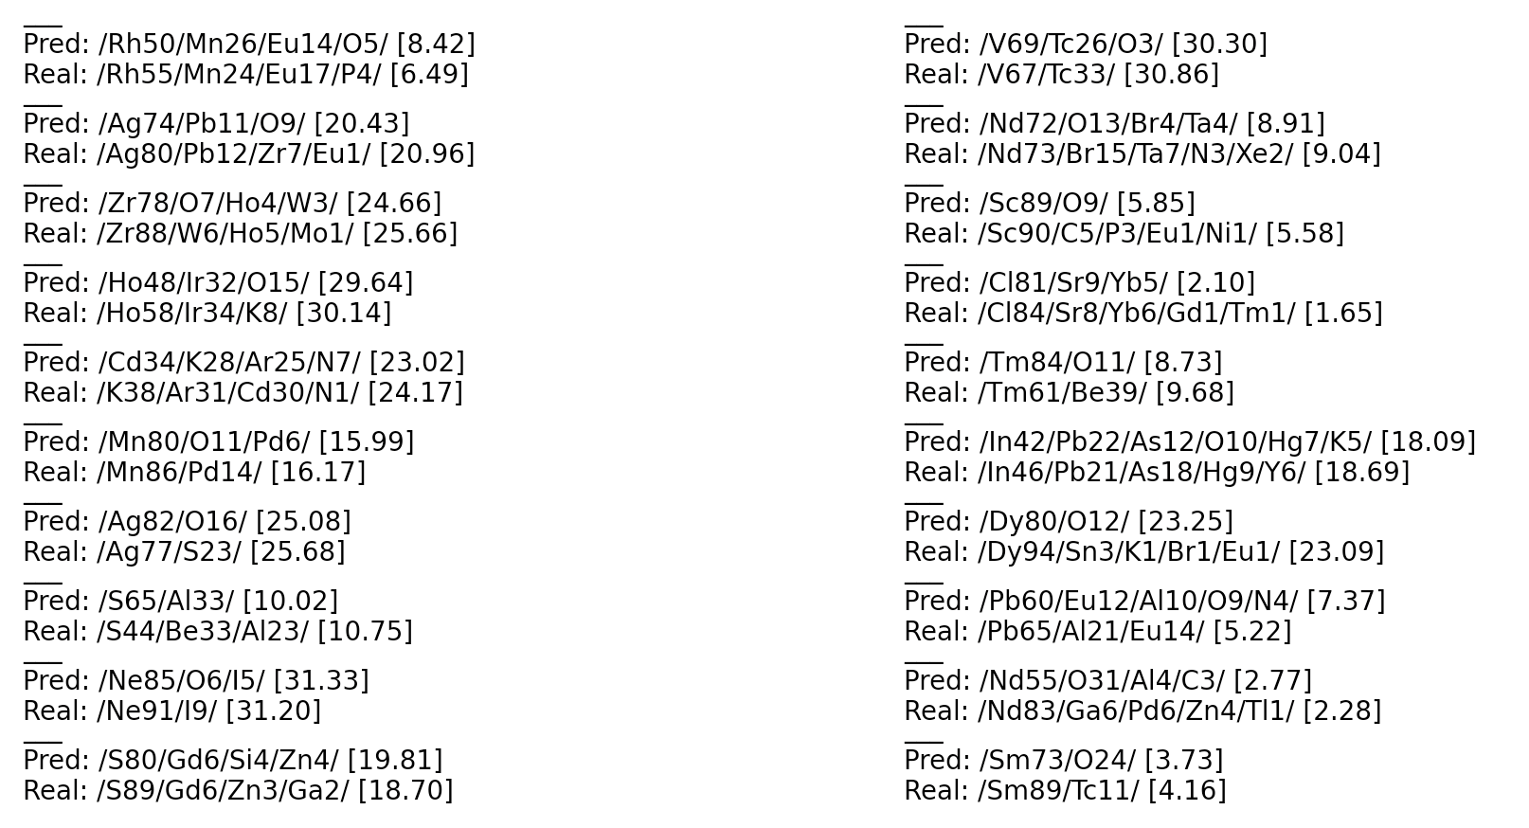
04/25 Lab Meeting
SPOND
이인호 박사님의 변형 모델
Notes:
https://iopscience.iop.org/article/10.1088/2632-2153/ab5da6

Slide 14
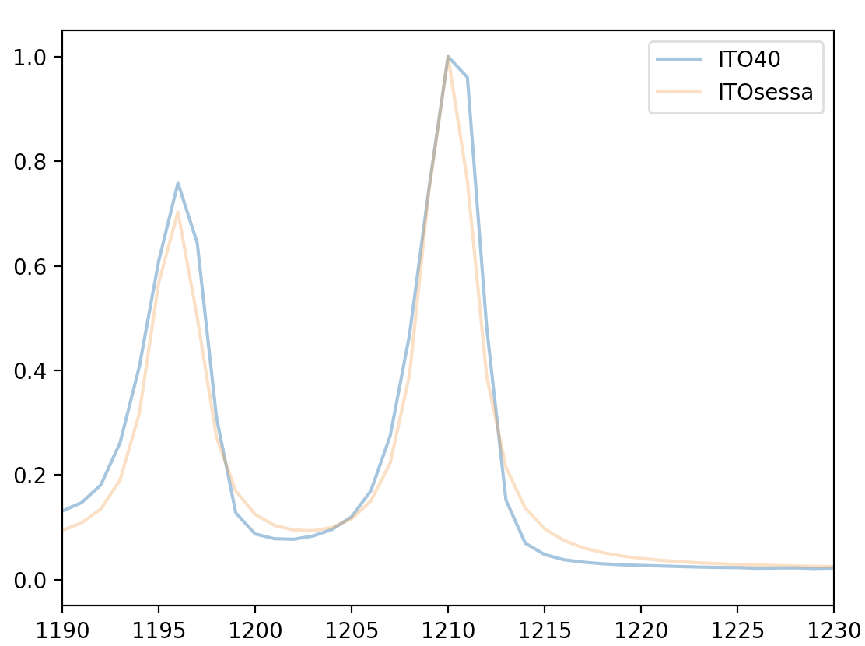
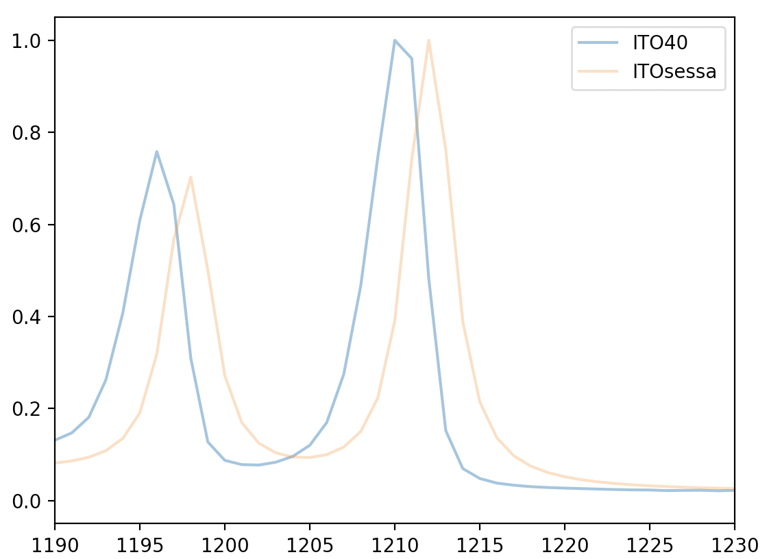
04/25 Lab Meeting
SPOND
Gaussian Filtering
Before convolution
각각 좌우 2칸(~1ev) shift
Notes:
https://iopscience.iop.org/article/10.1088/2632-2153/ab5da6

Slide 15
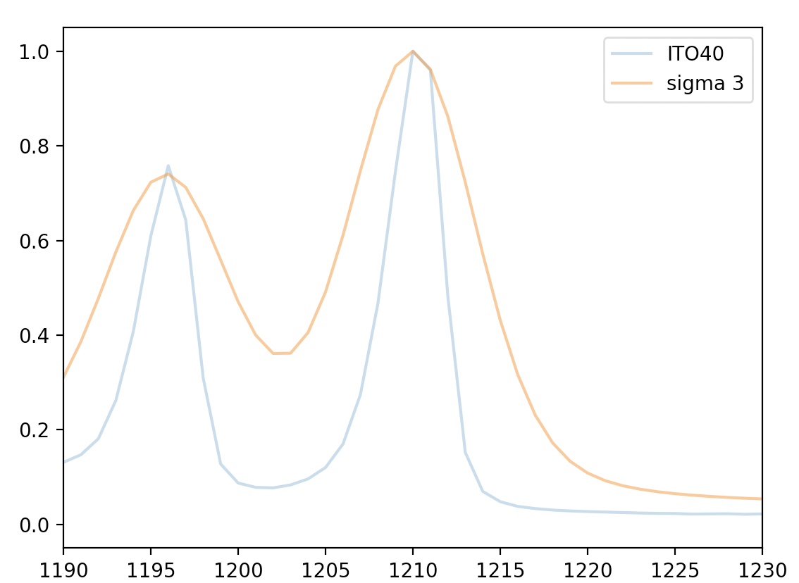
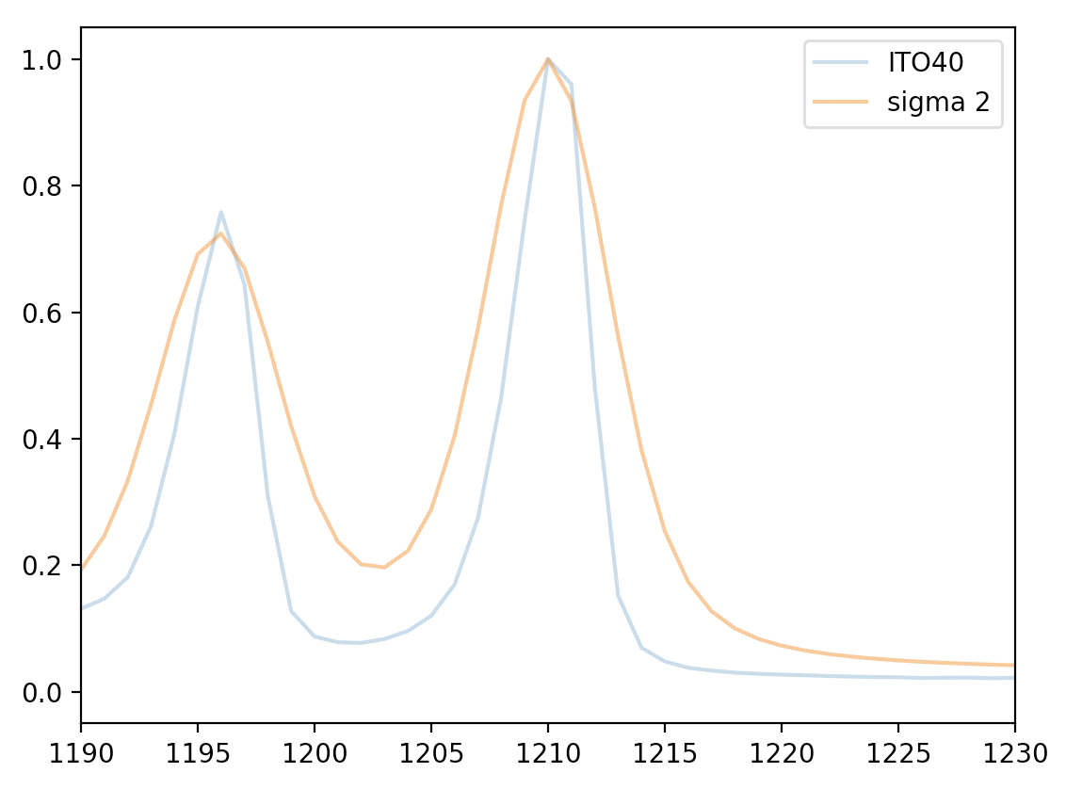
04/25 Lab Meeting
SPOND
Gaussian Filtering
Notes:
https://iopscience.iop.org/article/10.1088/2632-2153/ab5da6

Slide 16
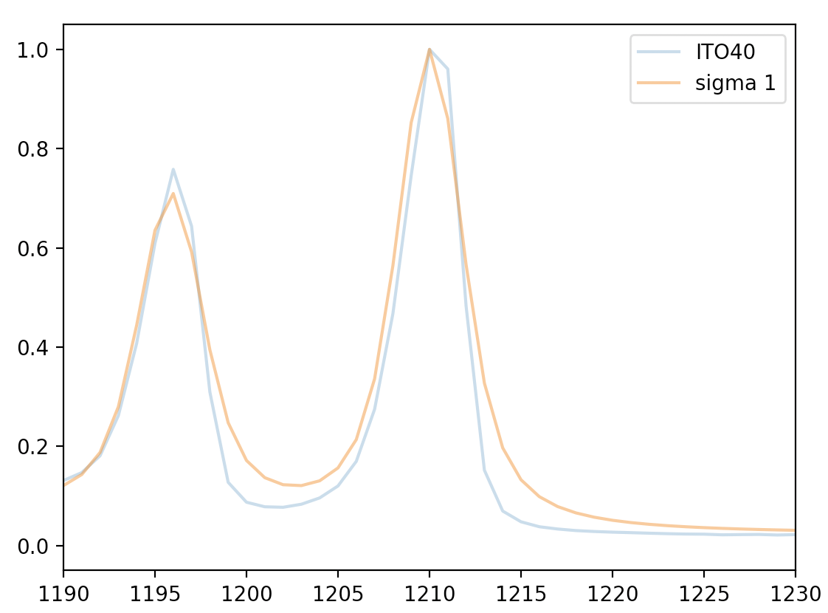
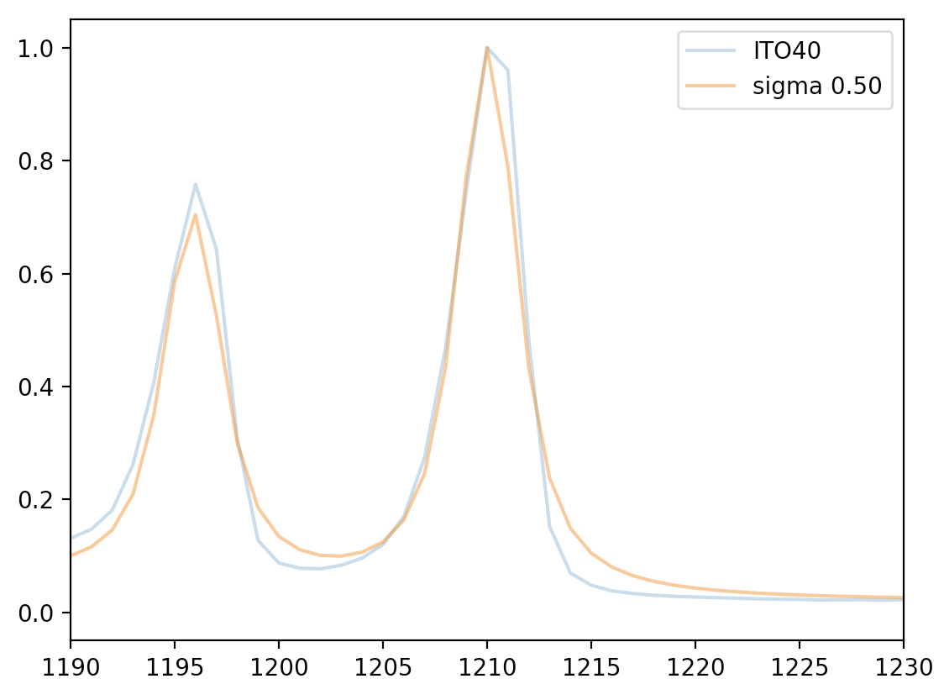
04/25 Lab Meeting
SPOND
Gaussian Filtering
Notes:
https://iopscience.iop.org/article/10.1088/2632-2153/ab5da6

Slide 17
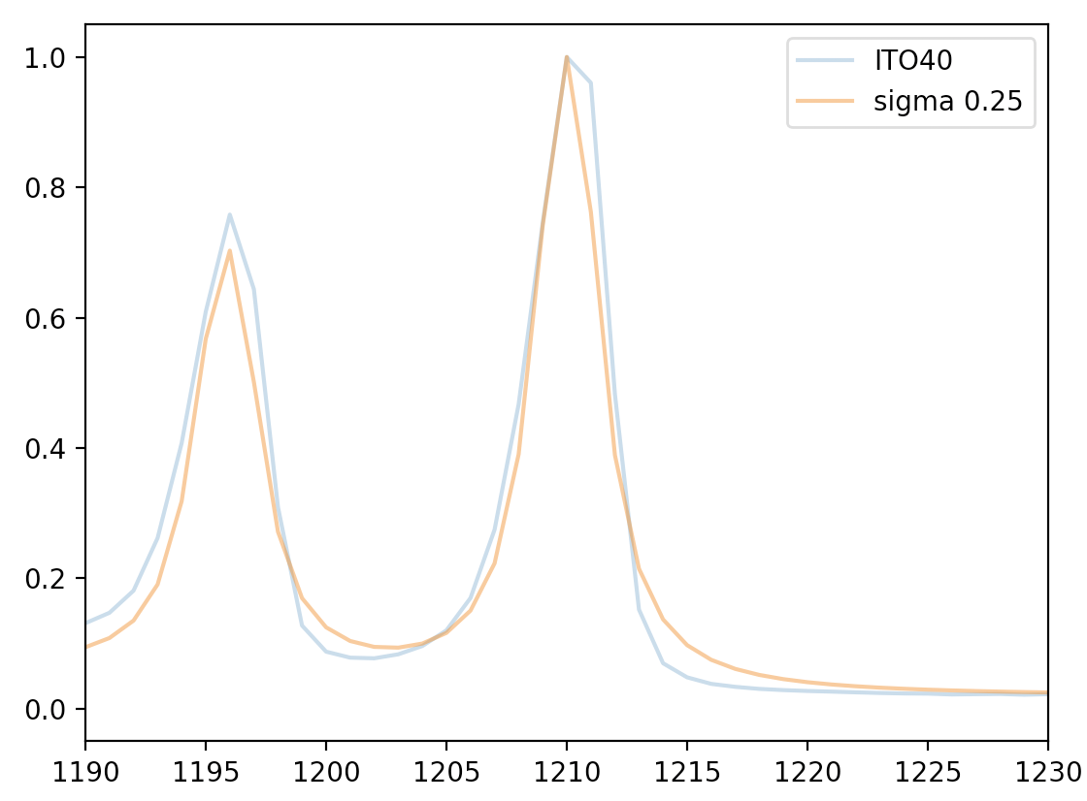
04/25 Lab Meeting
SPOND
Gaussian Filtering
Notes:
https://iopscience.iop.org/article/10.1088/2632-2153/ab5da6

